Slide 1



Introduction to Six Sigma
المعهد التكنولوجى لهندسة التشييد و الإدارة
Prepared By:
Said Fawzy
Manager of Information Center –Quality manager
Tendering Department
Arab Contractors

Slide 2

Chapter 03 :

Slide 3
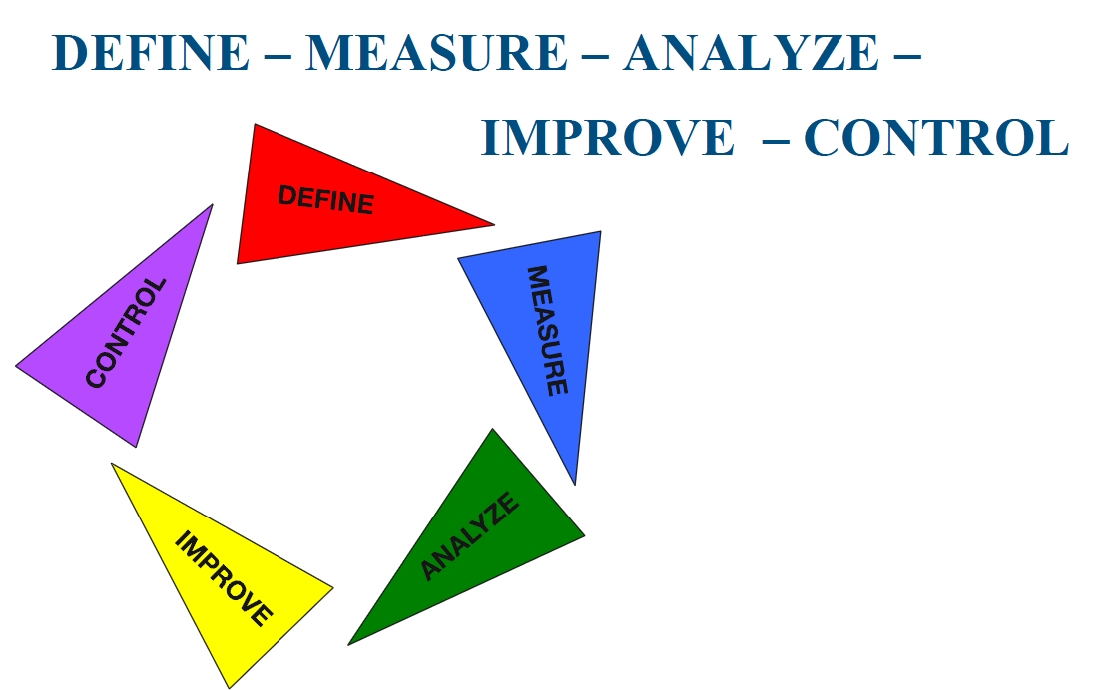

Slide 4
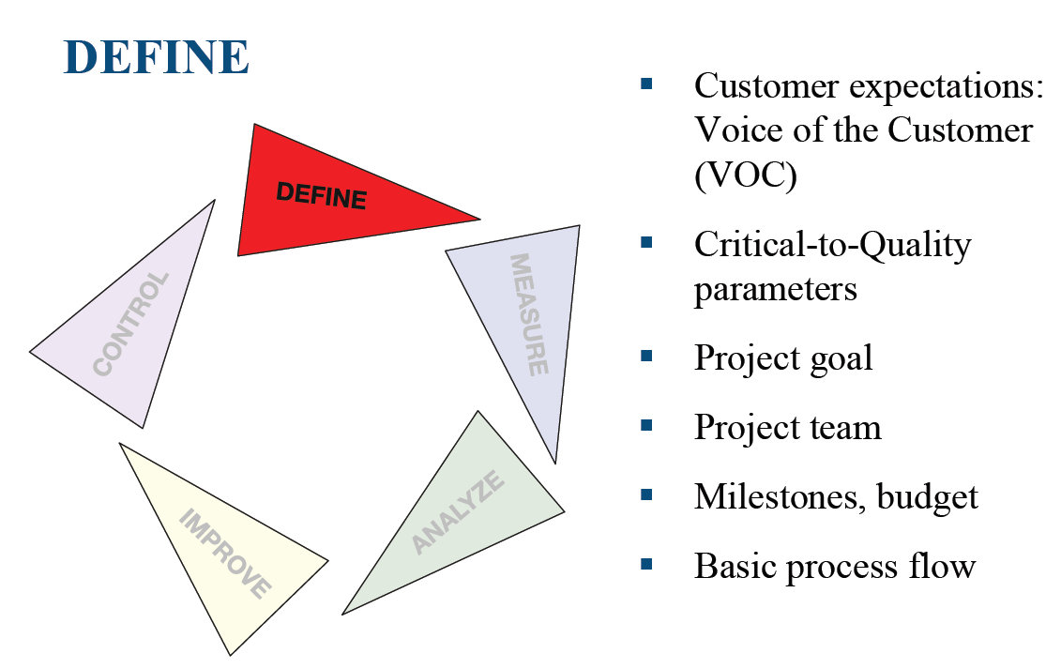

Slide 5
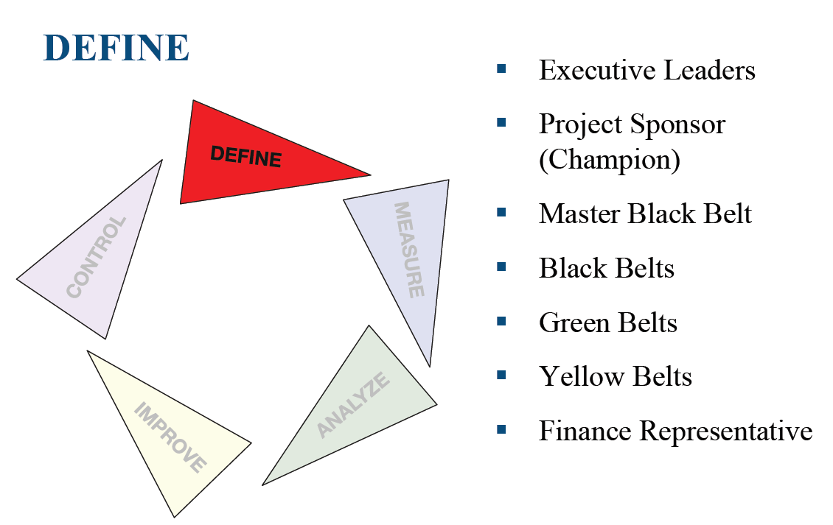

Slide 6
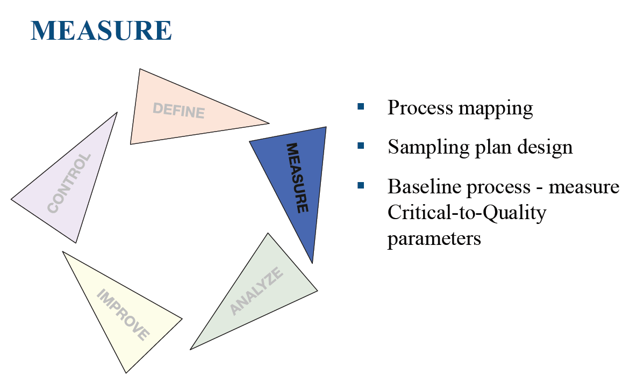

Slide 7
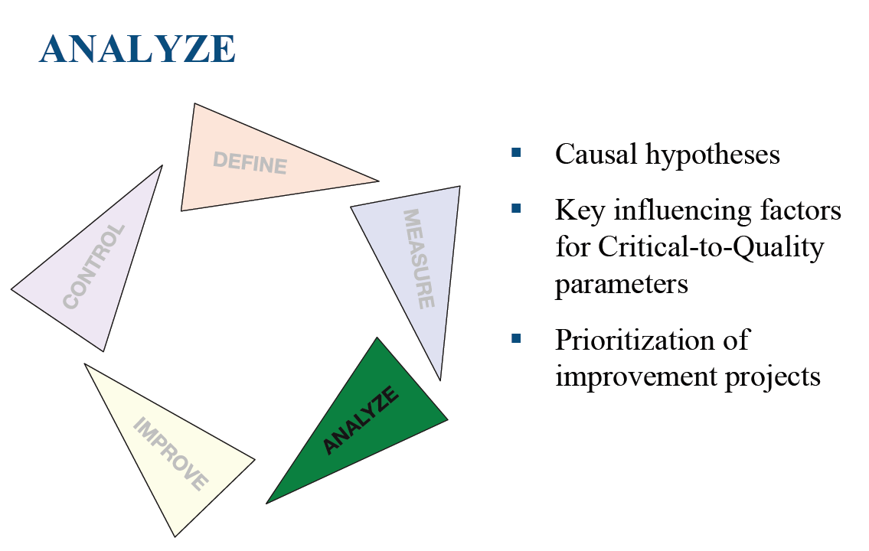

Slide 8
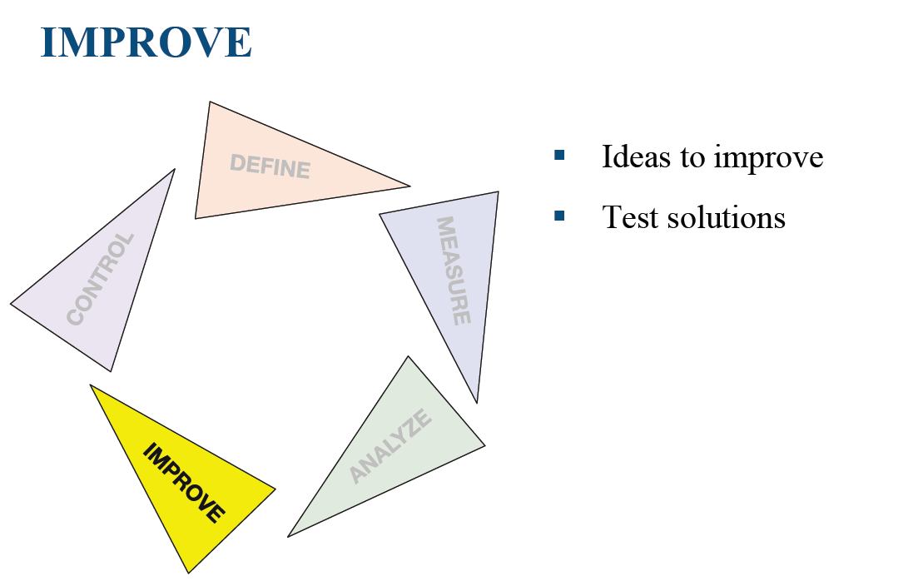

Slide 9
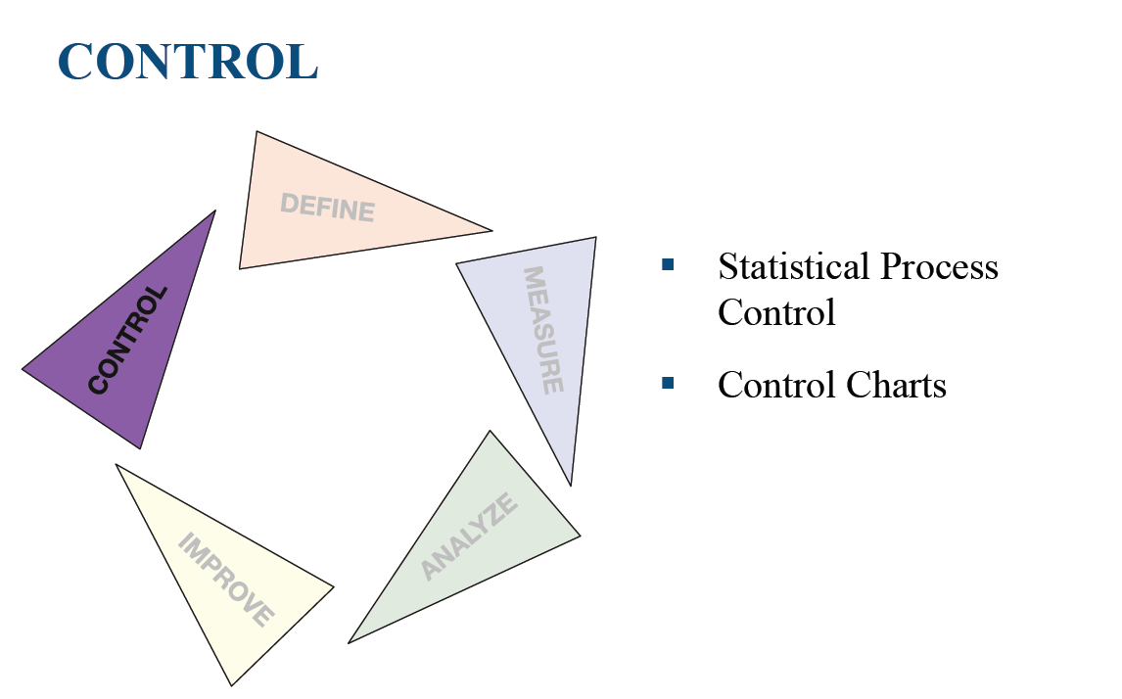

Slide 10
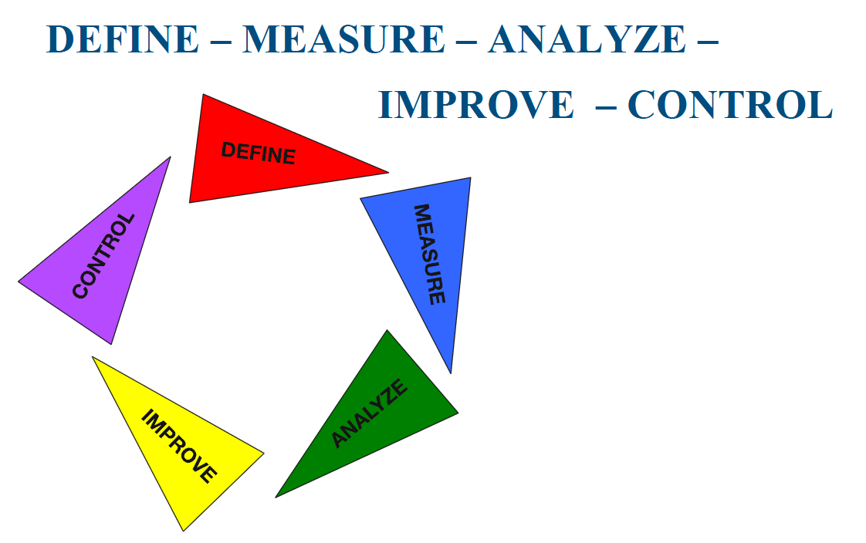

Slide 11
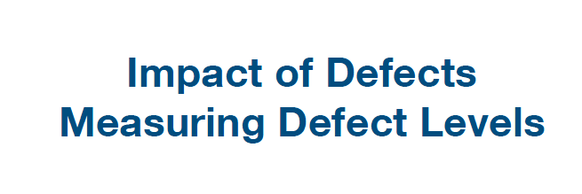
Chapter 04 :

Slide 12
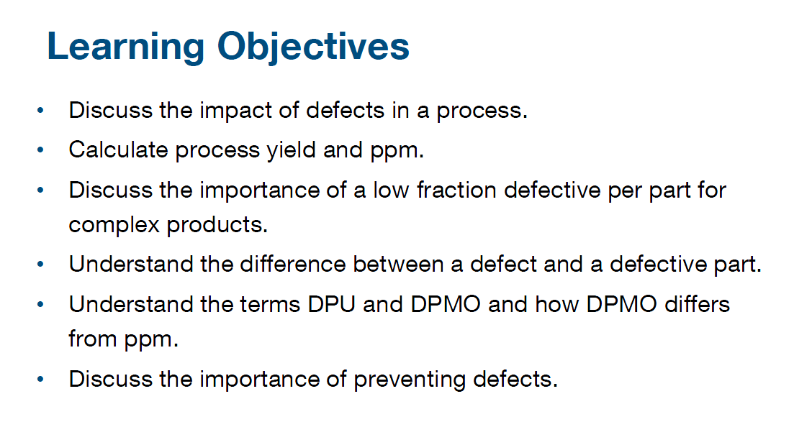

Slide 13
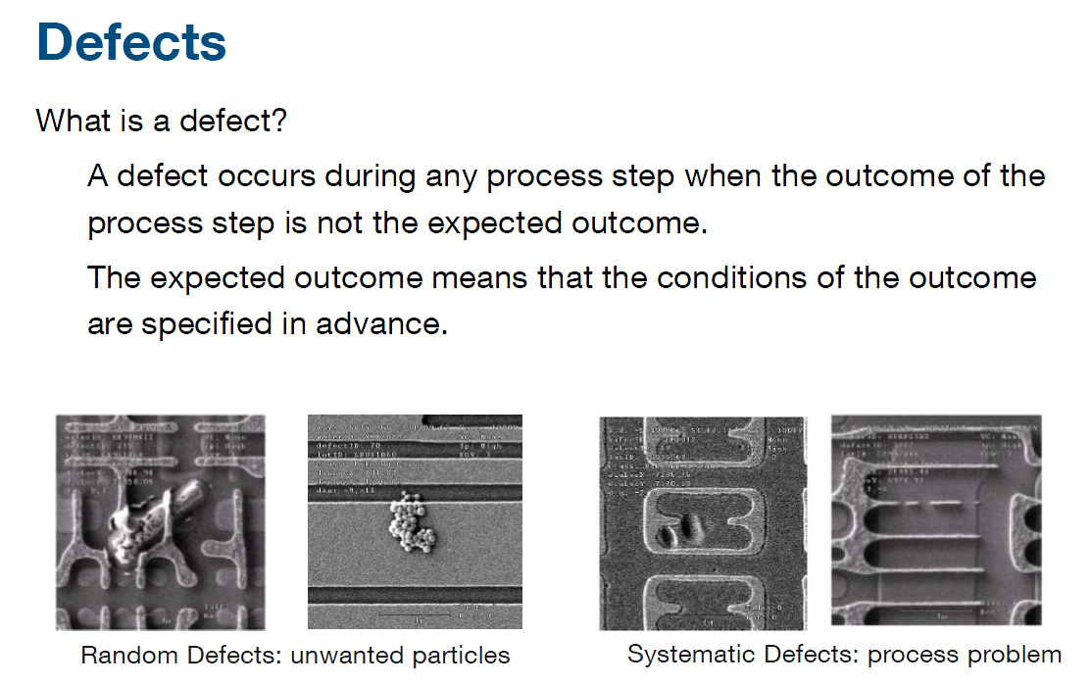

Slide 14
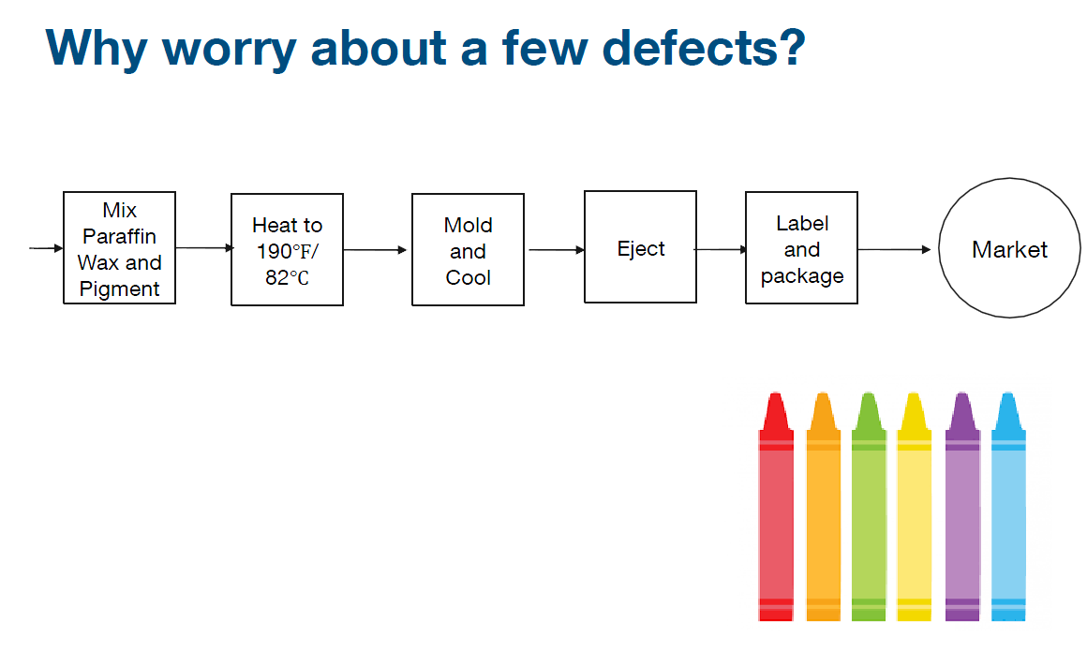

Slide 15
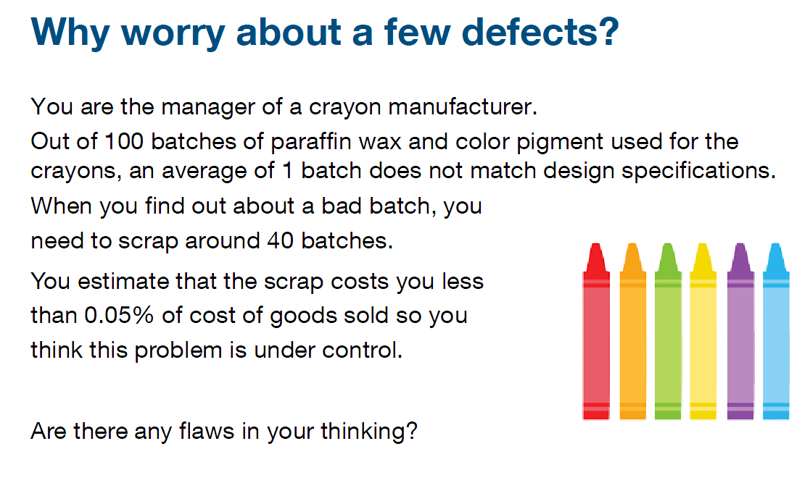

Slide 16
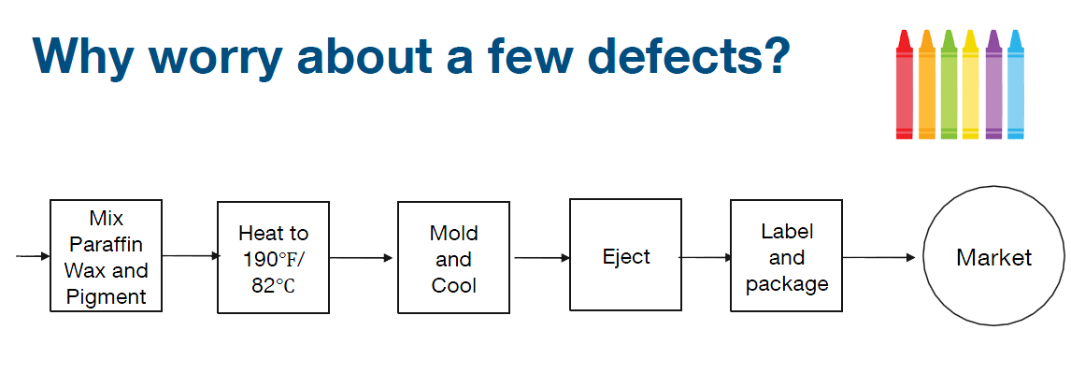

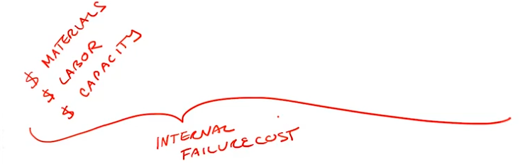
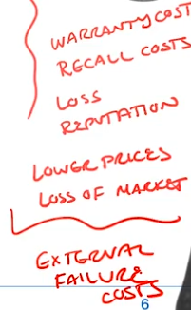


Slide 17
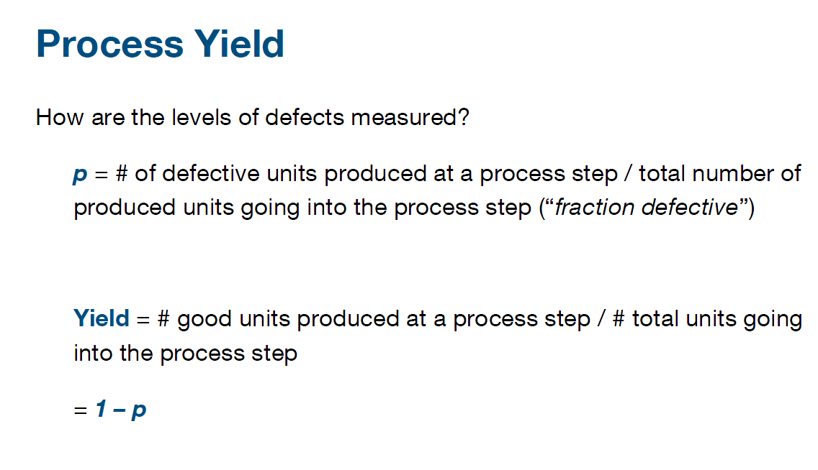

Slide 18
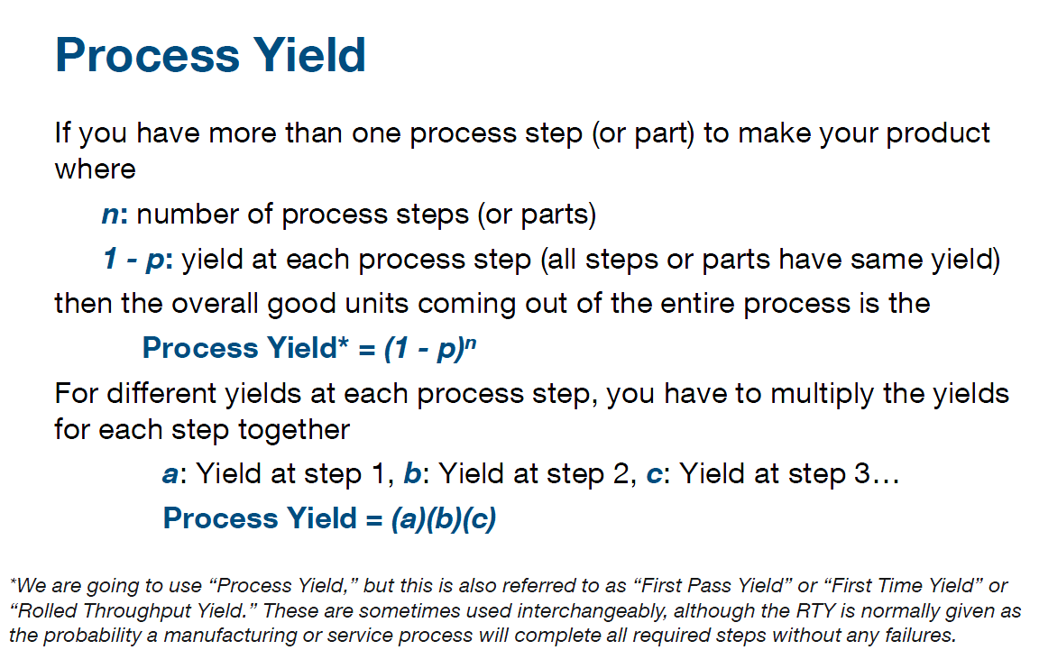

Slide 19
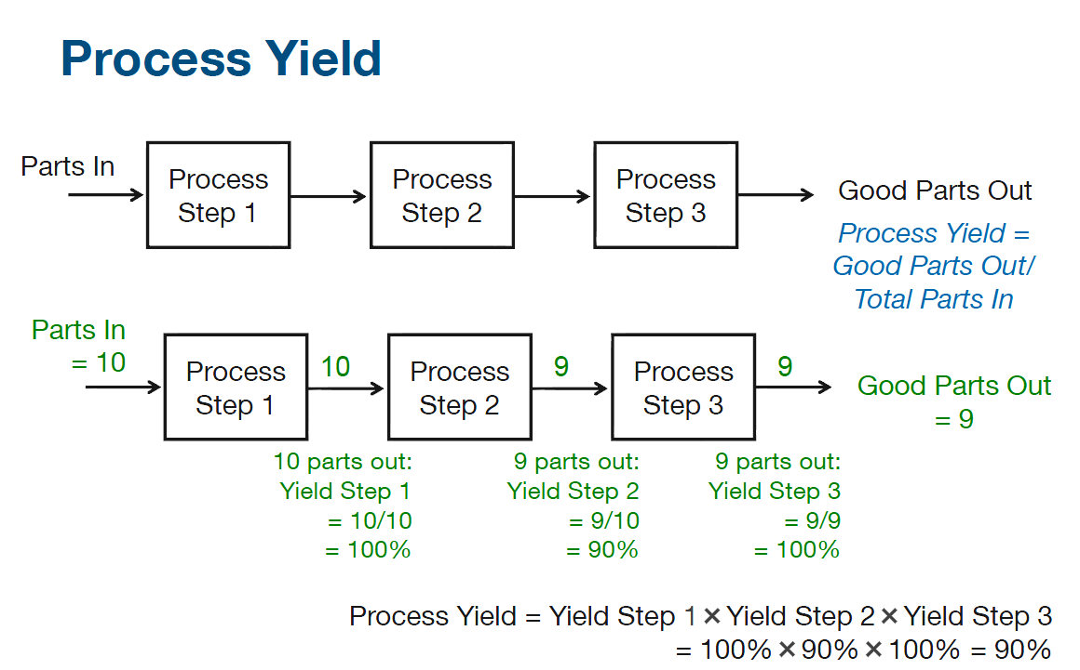

Slide 20
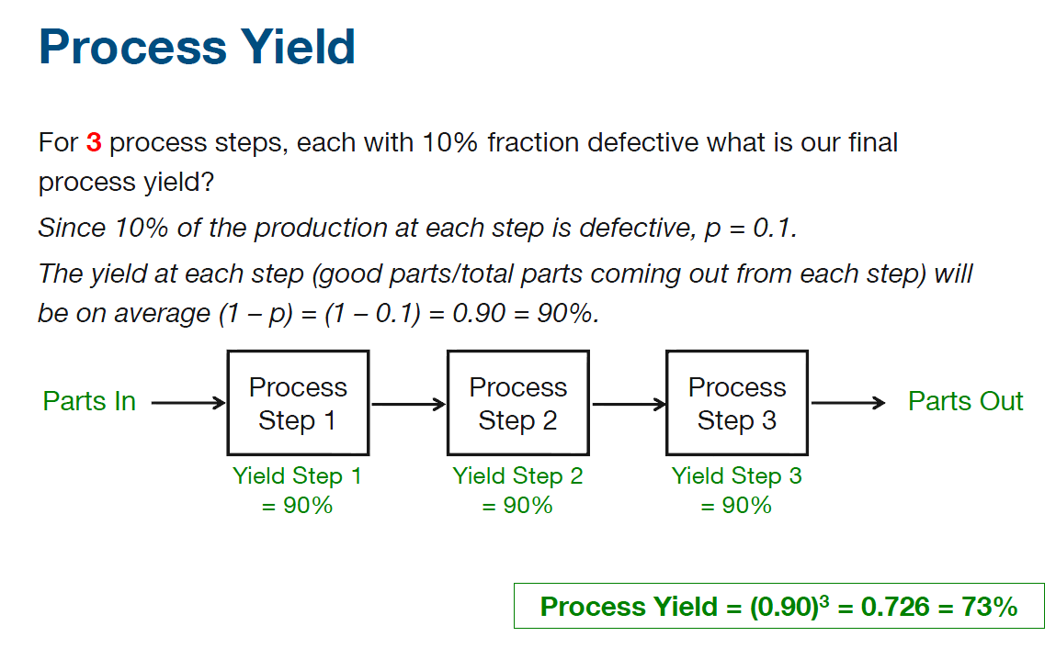

Slide 21
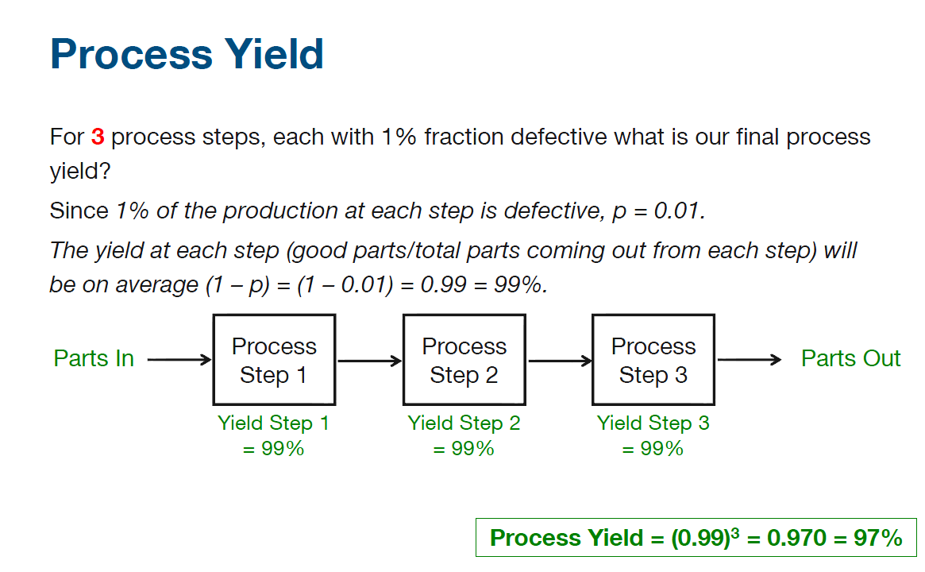

Slide 22
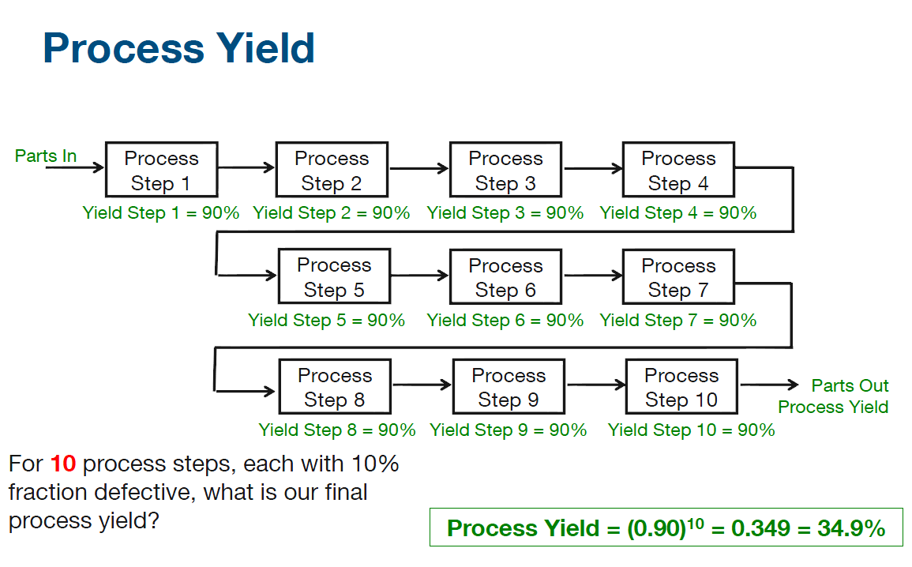

Slide 23
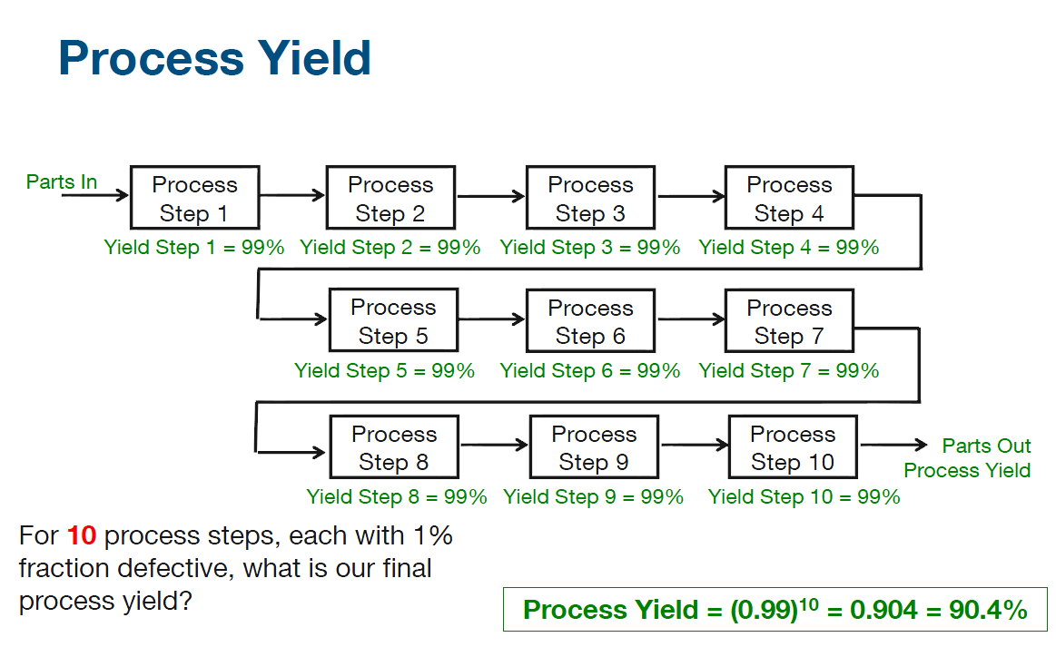

Slide 24
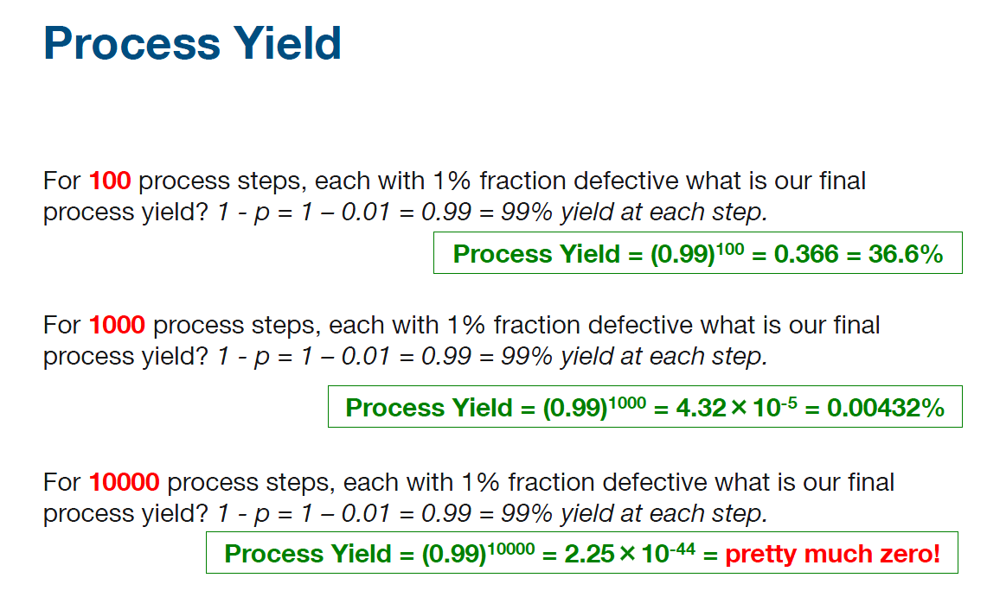

Slide 25
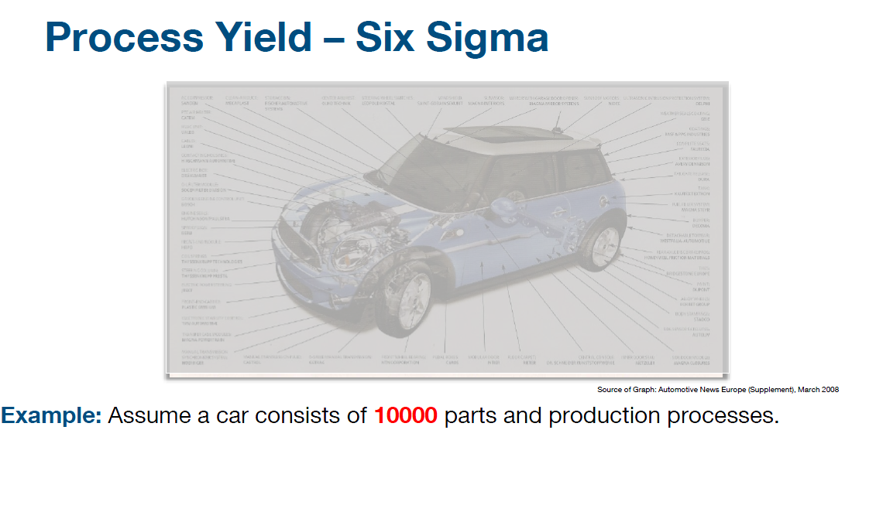

Slide 26
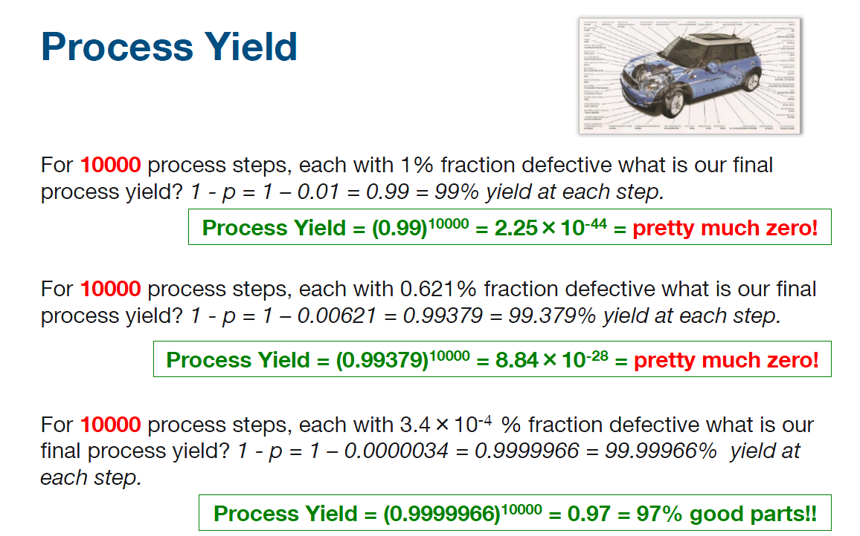

Slide 27
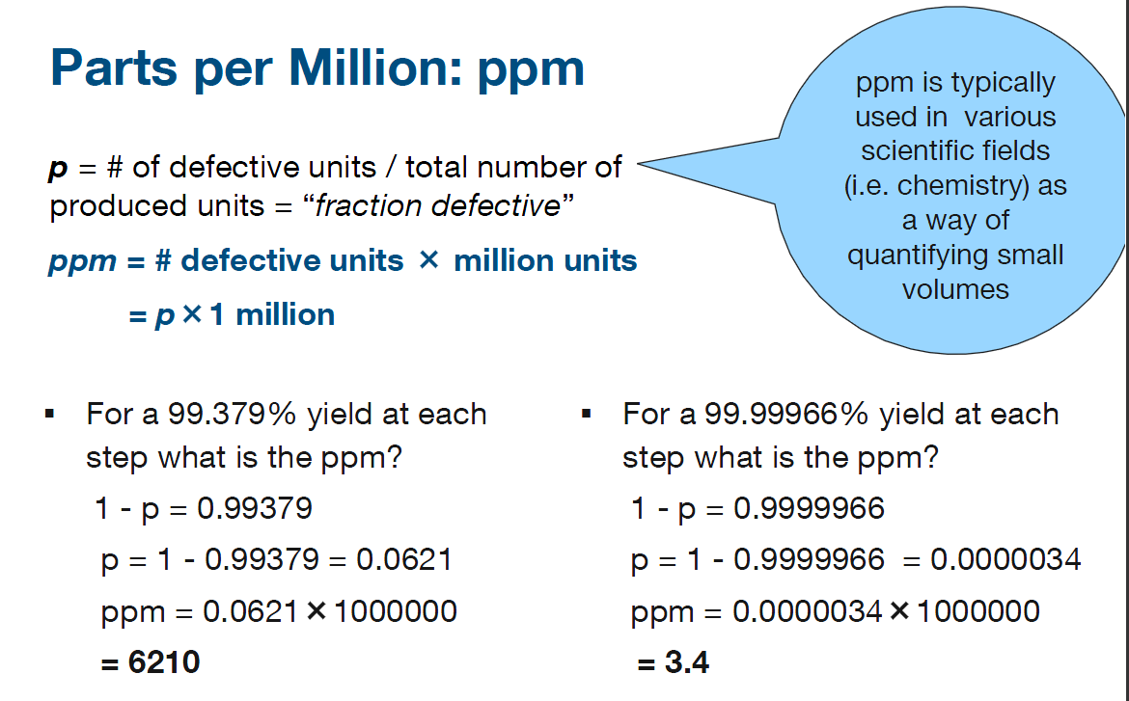

Slide 28
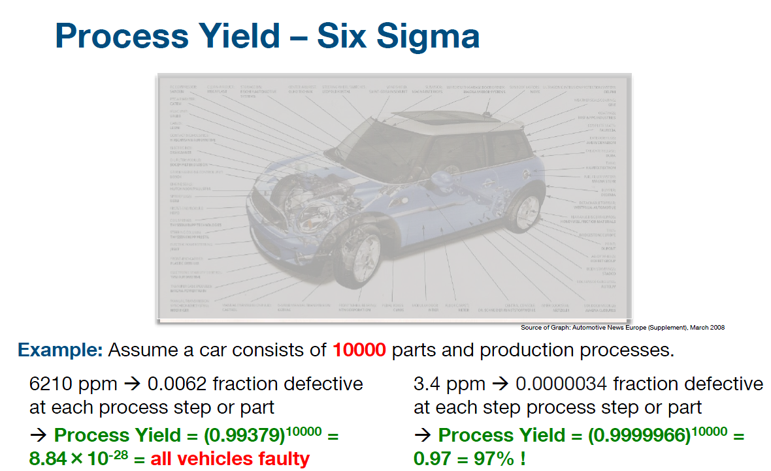

Slide 29
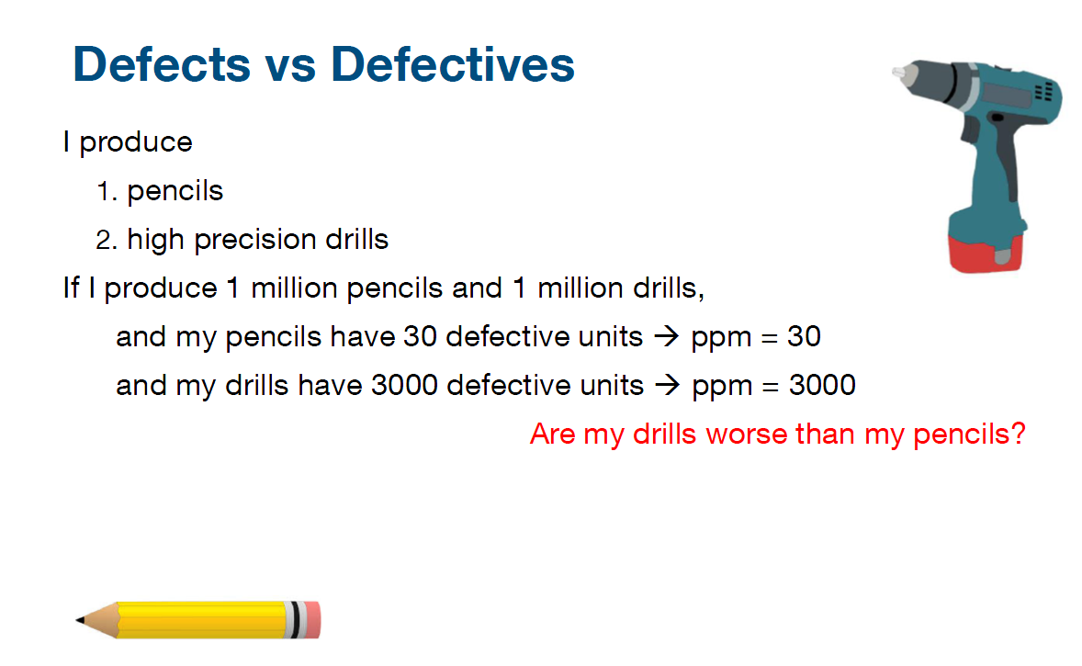

Slide 30
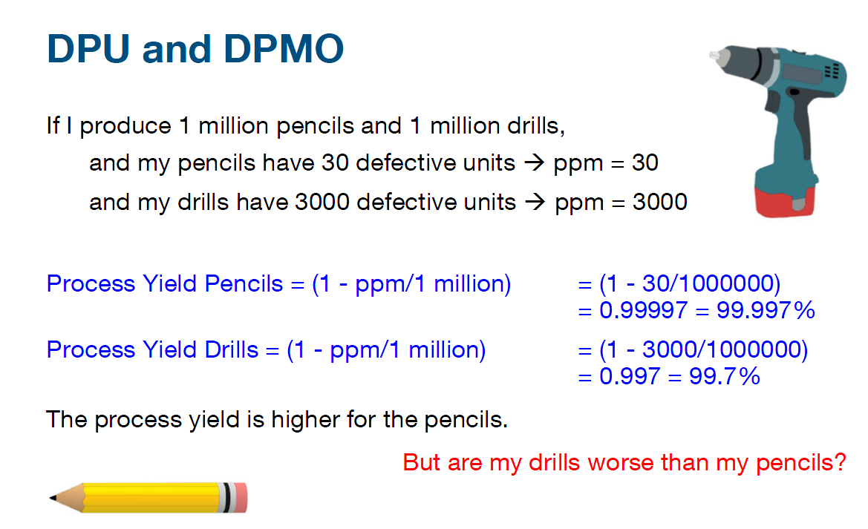

Slide 31
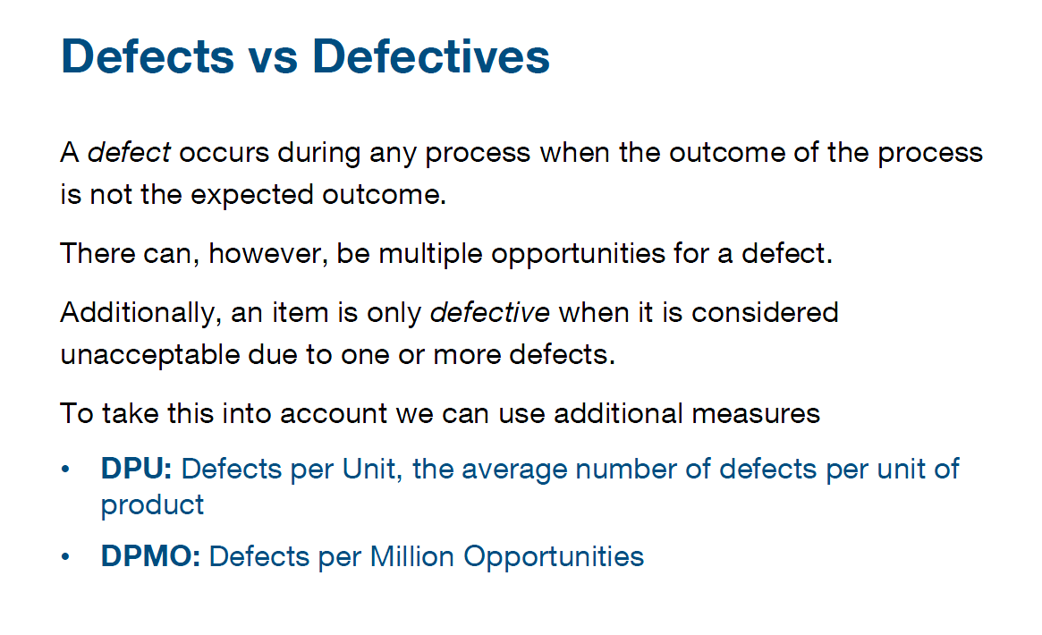

Slide 32
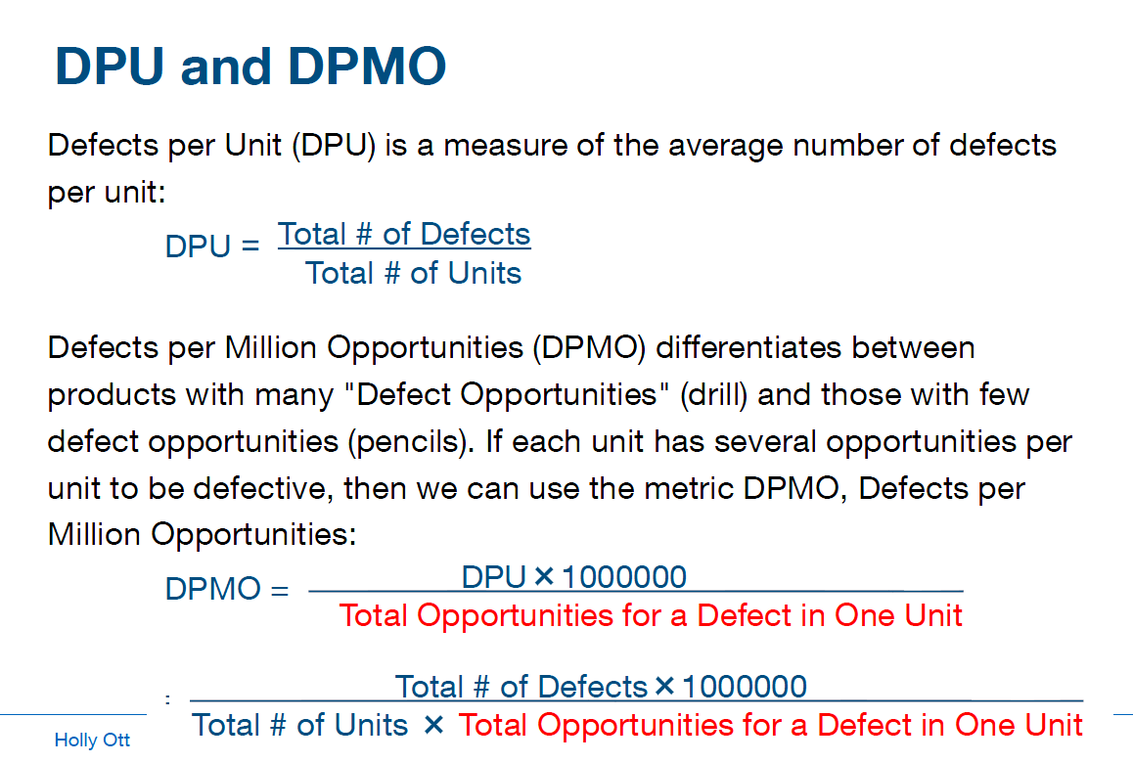

Slide 33
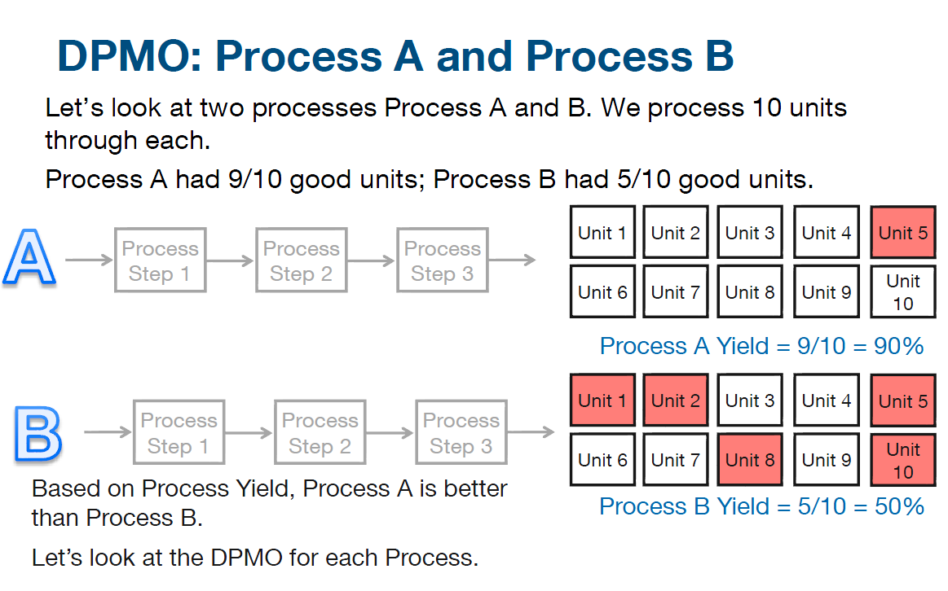

Slide 34
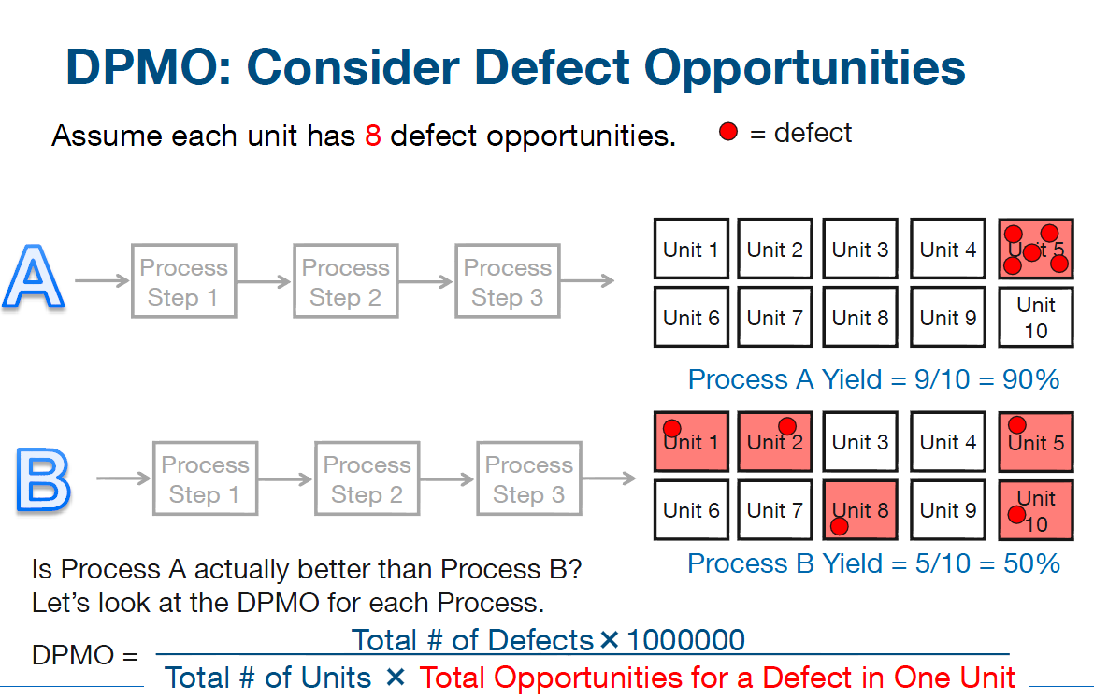

Slide 35
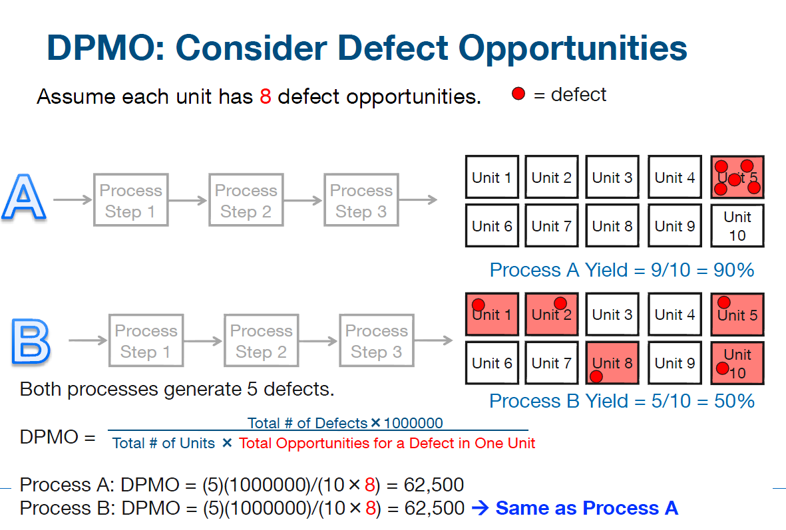

Slide 36
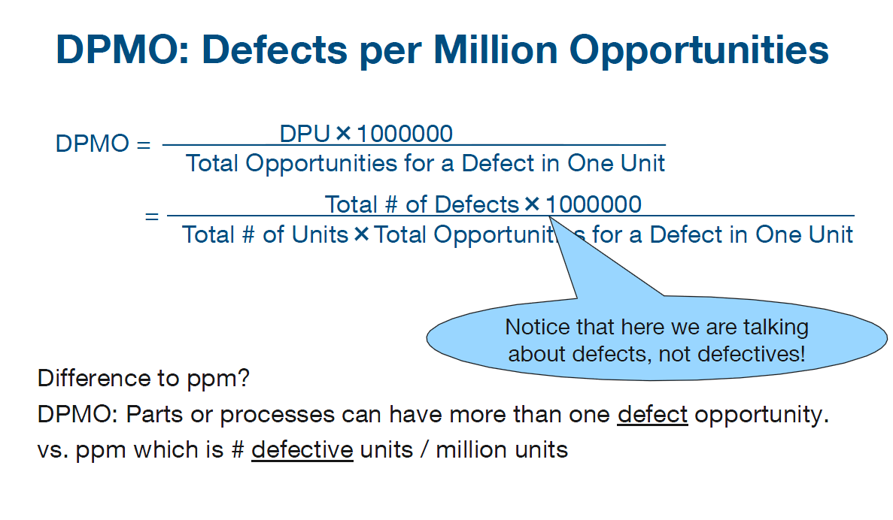

Slide 37
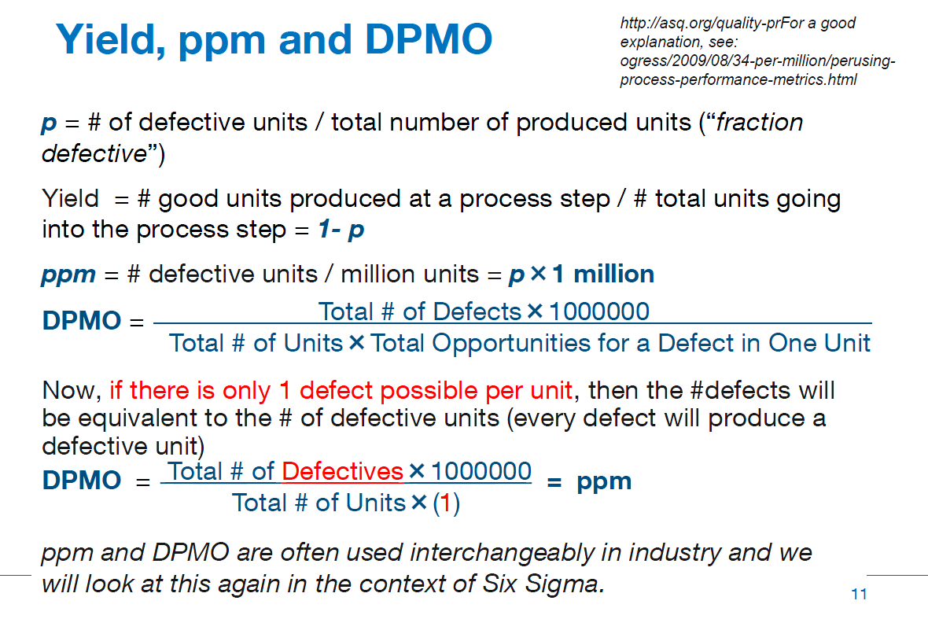

Slide 38
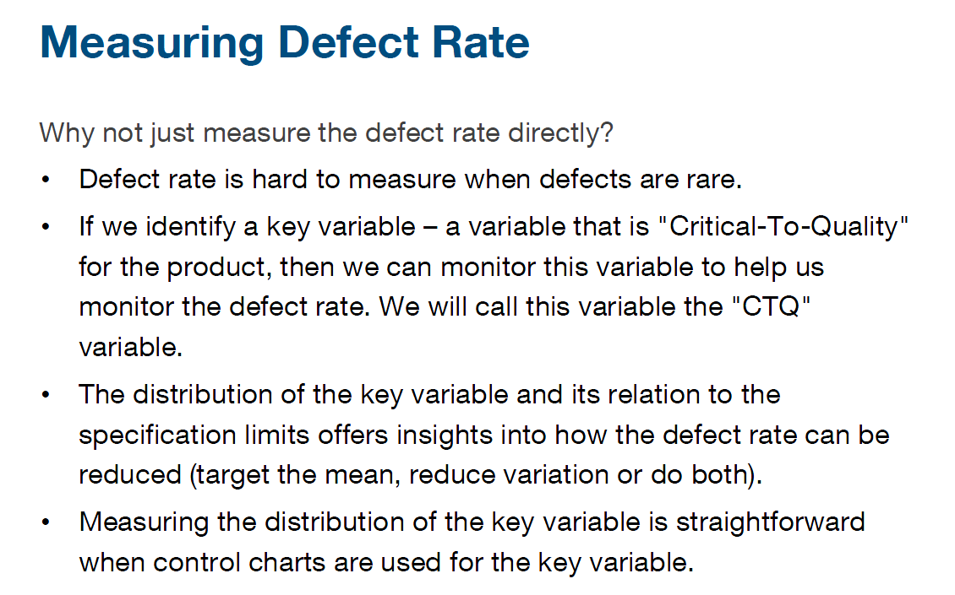

Slide 39
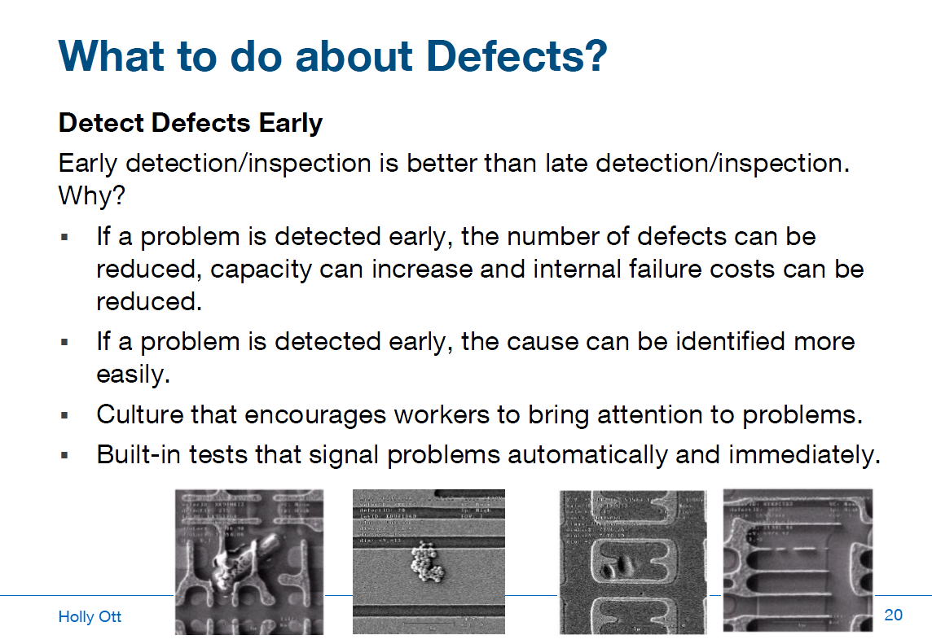

Slide 40
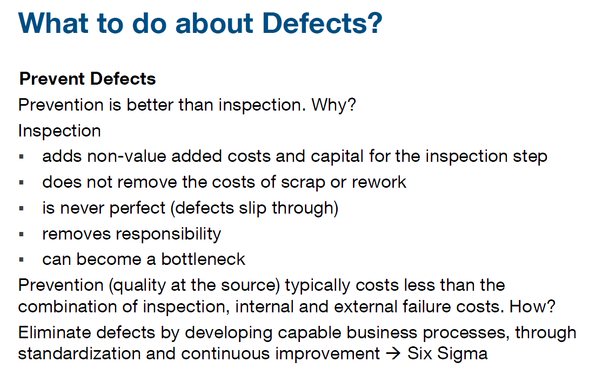

Slide 41
Questions

Slide 42

Question 1
For a 4 step process with yield = (1-p) = 90% at each step, what is the overall Process Yield?
90%
72.9%
65.61%
59.05%
Explanation
The Process Yield is calculated through (1-p)^n where (1-p) is 90% and n is 4.
Process Yield = (90%)^4 = 65.61%

Slide 43
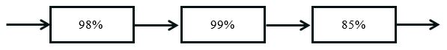
Question 2
Given a production process with three production steps as shown above, what is the overall Process Yield if the first production step has a yield of 98%; the second, of 99%; and the third, of 85%?
94.1%
94.7%
81.9%
82.5%
Explanation
If the production consists of three steps that each have a different Process Yield, then the overall Process Yield is calculated by: 0.98×0.99×0.85=0.82467 (≈82.47%)

Slide 44
Question 3
For 2 process steps, each with 5% fraction defective, what is our final Process Yield?
0.25%
90.25%
97.5%
85.74%
Explanation
Since 5% of the production at each step is defective, p = 0.05 and the number of steps is n=2.
Process Yield = (1-p)^n = (1-0.05)^2 = (0.95)^2 = 90.25%

Slide 45
Question 4
For 4 process steps, each with a yield of 25%, what is our final Process Yield?
31.64%
0.39%
30%
1.73%
Explanation
Since the yield at each step is 25% of the production at each step, (1-p) = 0.25. The number of steps is n=4.
Process Yield = (1-p)^n = (0.25)^4 = 0.00396 = 0.3906% (≈0.39%)

Slide 46
Question 5
For a 95% yield at each step what is the ppm (Parts per Million) defective?
95000
50000
950000
500000
Explanation
p = 1-0.95 = 0.05
ppm = 0.05x1000000 = 50000

Slide 47
Question 6
For a 99.999% yield at each step what is the ppm (Parts per Million) defective?
1000
100
1
10
Explanation
p = 1-0.99999 = 0.00001
ppm = 0.00001x1000000 = 10

Slide 48
Question 7
What is the difference between Defects and Defectives?
A defect occurs when an item is unacceptable. A defective process occurs when the process outcome is not the expected outcome.
A defect occurs when the process outcome is exactly the expected outcome. A defective item is unacceptable due to one or more defects.
A defective occurs when a process outcome is not the expected outcome. A defect item is unacceptable due to one or more defects.
A defect occurs when a process outcome is not the expected outcome. A defective item is unacceptable due to one or more defects.
Explanation
See Lecture

Slide 49
Question 8
Which are the correct definitions of Defects per Unit (DPU) and Defects per Million Opportunities (DPMO)?
DPU = (Total # of Defectives)/(Total # of Units); DPMO = (DPUx1000000)/(Total # of Units)
DPU = (Total # of Defects)/(Total # of Units); DPMO = (DPUx1000000)/(Total Opportunities for a Defect in One Unit)
DPU = (Total # of Units)/(Total # of Defects); DPMO = (DPUx1000000)/(Total Opportunities for a Defect in One Unit)
DPU = (Total # of Defects)/(Total # of Units); DPMO = (DPUx1000000)/(Total # of Units)
Explanation
See Lecture

Slide 50


